Slide 1

There are a lot of opportunities out there to help mothers build an online business working from home.

Slide 2
Some work... Most DON’T.

Slide 3
Unfortunately, most methods promise the world, but just don’t deliver on helping and teaching you to get the results that you want.

Slide 4
But, what if there was a guide that would very quickly get you the results you're wanting. Not just for the short term, but for the LONG TERM TOO.

Slide 5
Not only that but helping you learn the correct mindset to find the right opportunities to start. working from home

Slide 6
If you’re planning to start working from home as a mother then you need a guide that can provide you with everything to help you succeed.

Slide 7
So, let me introduce you to...

Slide 8
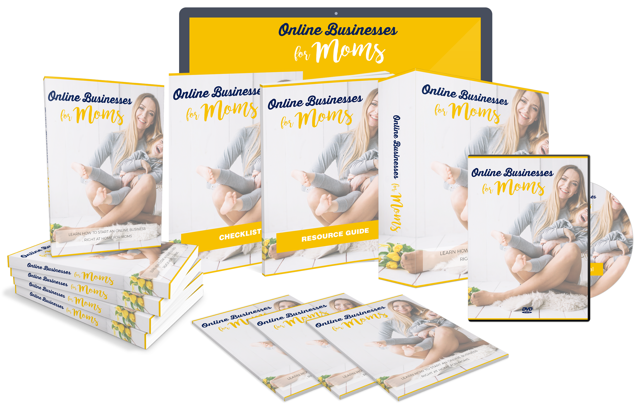

Slide 9
A guide that is jammed packed with tried and tested METHODS so you can see results fast.

Slide 10
There are so many products available in teaching you how to start an online business from home, making it a challenge to know what the best solution is for you.

Slide 11
These resources can be helpful, and it’s a great idea to research each one of them to know what will work best for you and what methods you should use.

Slide 12
But what you're needing is a convenient all-in-one resource that will help you to become more knowledgeable in this subject before you begin.

Slide 13
That's why this new guide all about building online businesses for Moms is a guide that covers all these topics in one.

Slide 14
This is an easy-to-follow guide, and anyone can use it to start learning everything there is to know about this subject.

Slide 15
So, whether you're already have started an online business or planning to start, then this product will guide you through the main principals to help you master everything there is to know about this subject.

Slide 16
Don’t wait and end up missing out.

Slide 17
Grab your copy now by clicking the button below to gain instant access today!

